Slide 1
Start-ups
By 2/c Matt Varney and 2/c Will Sergio

Slide 2
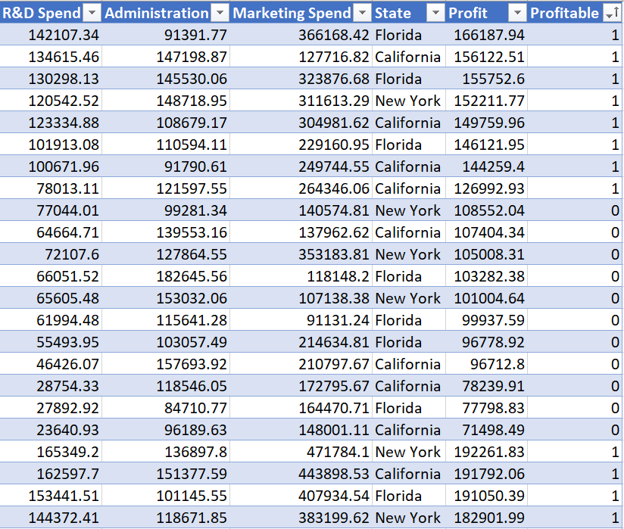
Overview of data

Slide 3
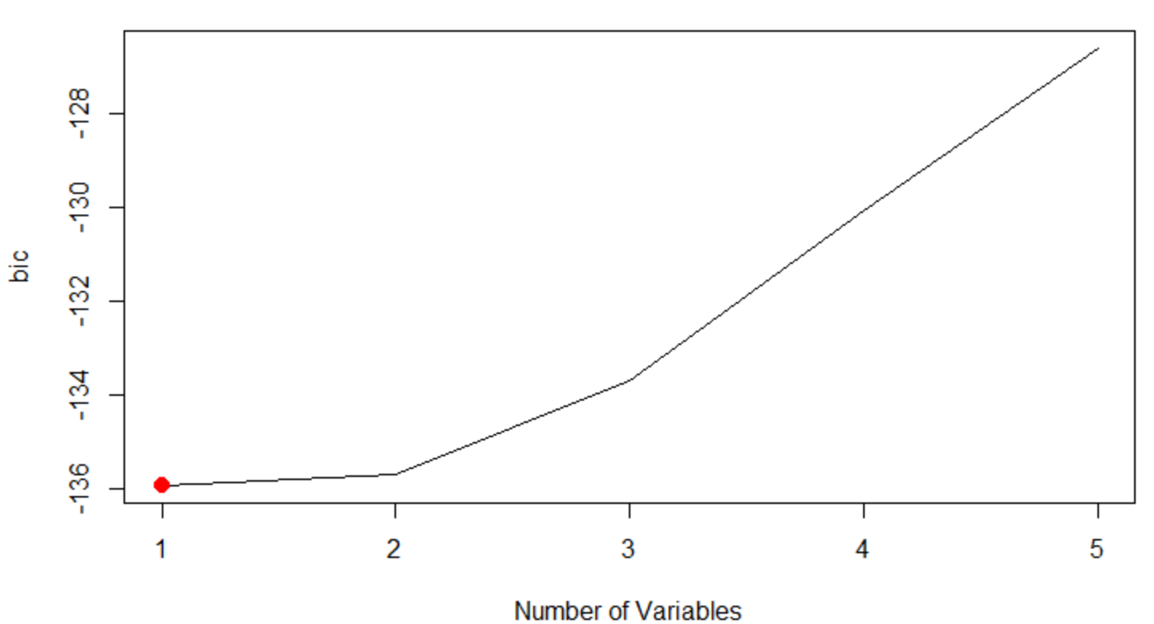

Bayesian Information Criterion (BIC)
Estimate for test error
n = number of observations
d = number of predictors
Low BIC suggests accurate model

Slide 4
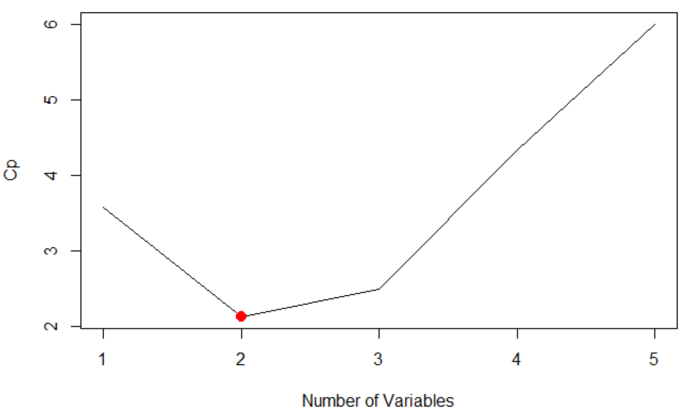

Cp
Estimate for test error
n = number of observations
d = number of predictors
Low Cp suggests accurate model

Slide 5
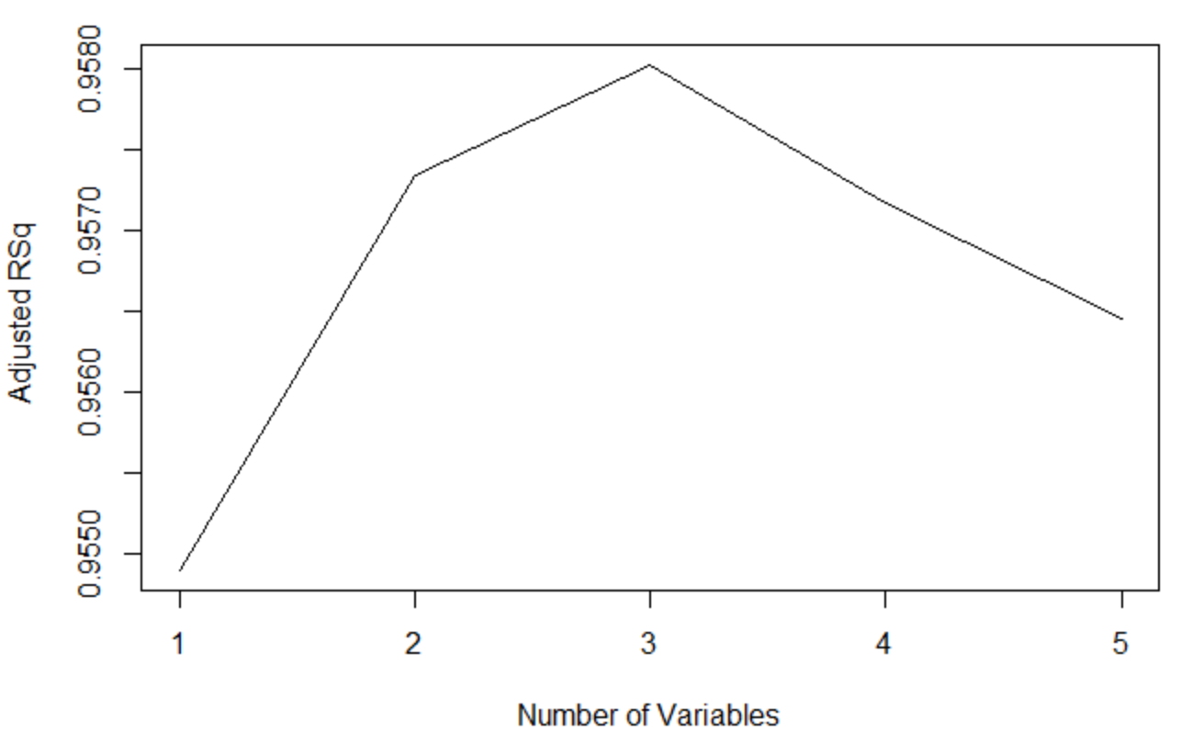
Adjusted R^2
Identical to R^2 but ads a penalty with an increase in number of predictor variables

Slide 6
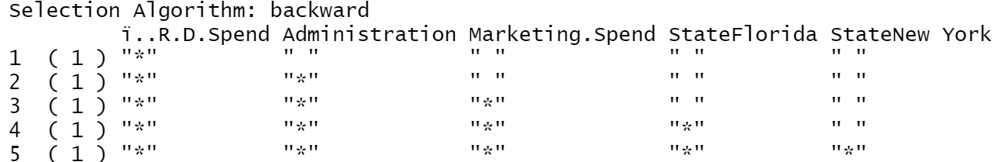
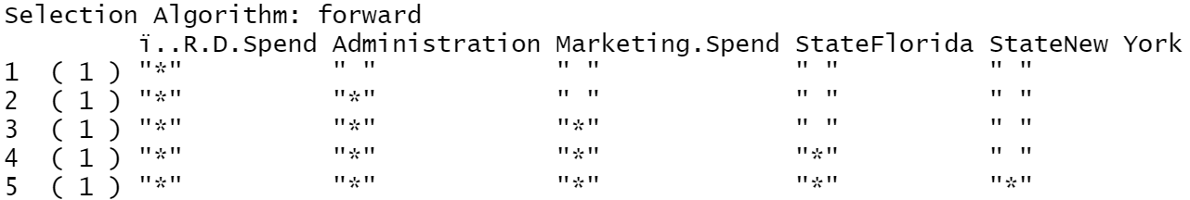
Forward/Backward Selection results

Slide 7
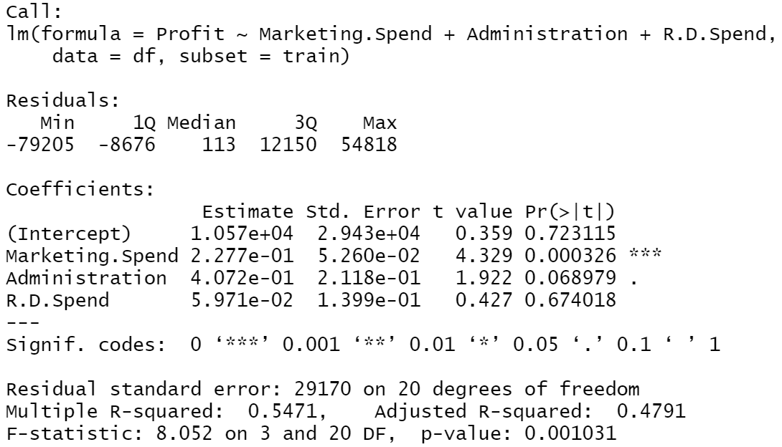
MLR #1

Slide 8
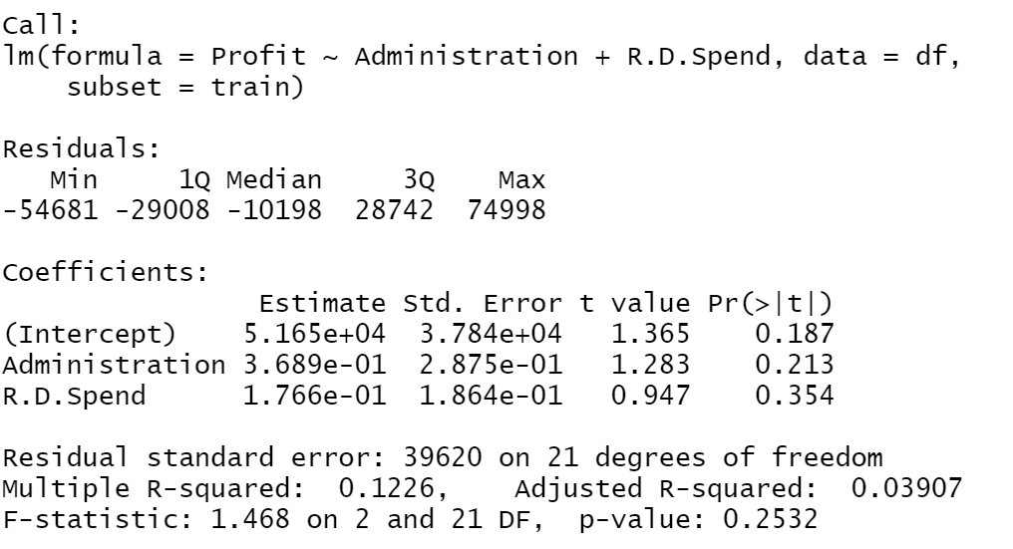
MLR #2

Slide 9
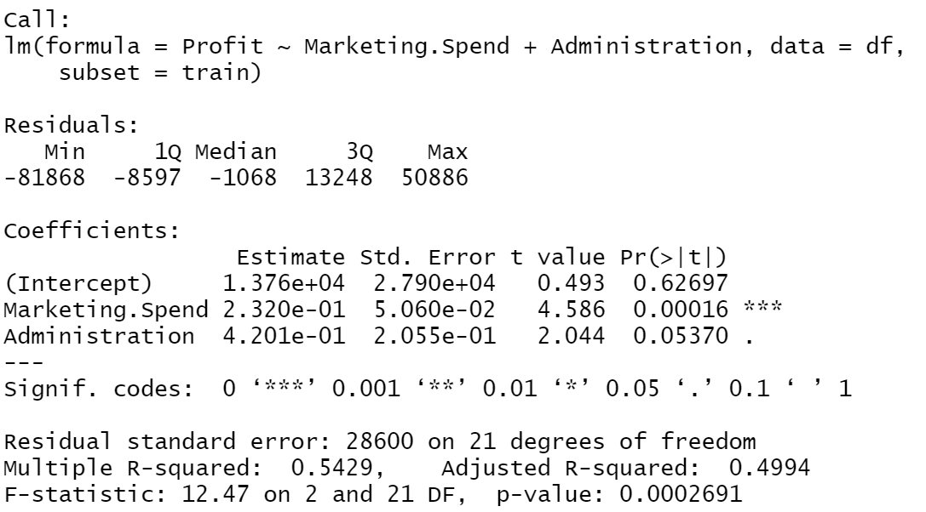
MLR #3

Slide 10


Final MLR
Y (Profit) = .232 * ( Marketing.Spend) + .4201 * (Administration) + 13760

Slide 11
What’s Next? → Logistic Regression is next

